Slide 1
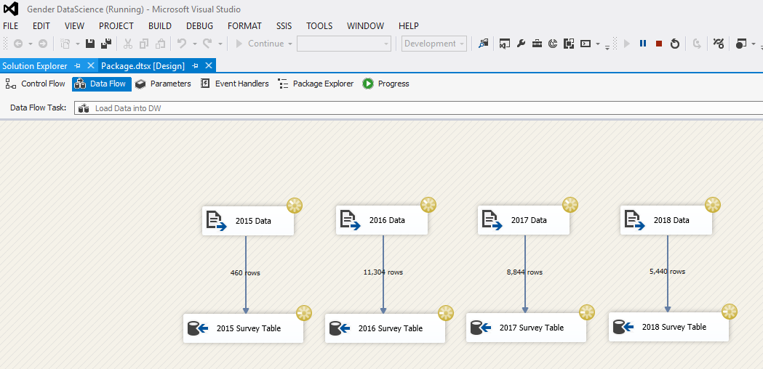
Data Science Journey
Loading the Data into our Data-Warehouse using SSIS

